Slide 1
Today’s Agenda
Different types of Boolean functions representation
Boolean function simplification using K-map

Slide 2
Canonical Form
Boolean functions expressed as SOP and POS are said to be in canonical form.
In canonical form each minterm and maxterm contain all variables either in original or in complemented form.

Slide 3
Maxterms and Minterms Relationship:
For example:
Minterms
x y z Minterm
0 0 0 x’y’z’ m₀
0 0 1 x’y’z m₁
…
1 0 0 xy’z’ m₄
…
1 1 1 xyz m₇
For example:
Maxterms
x y z Maxterm
0 0 0 x+y+z M₀
0 0 1 x+y+z’ M₁
…
1 0 0 x’+y+z M₄
…
1 1 1 x’+y’+z’ M₇
m_{j}’= M_{j}

Slide 4
Conversion Between Canonical Form
x
0
0
0
0
1
1
1
1
y
0
0
1
1
0
0
1
1
z
0
1
0
1
0
1
0
1
F₁
0
1
0
0
1
0
0
1

Slide 5
Standard Form
Besides canonical form a Boolean function can also be represented as Standard form.
There are two types of Standarsd form;
Sum of product standard form:
F4(x,y,z)= xy + y’z
Product of sum standard form:
F5(x,y,z) = (x + y’)(y + z)

Slide 6
Non Standard Forms
A function may be written in non standard form:
F6 = (xy + z)(xz + y’z)

Slide 7
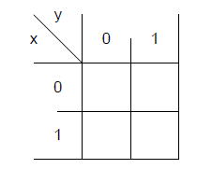
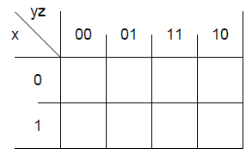
K-Map
K- map is graphical representation of truth table.
Each cell of K-Map corresponds to one minterm of function.
Adjacent cells differ by one literal i.e x or x’.
Used to simplify the 2,3,4 and 5 variables expressions.

Slide 8
Simplification Using K- Map
  Steps:
    From expression, draw the required no. of boxes
    Expression should be in “Sum of Product/Minterms form
    (If not already) Express function in sum of minterms
    Input the function → K-map (insert ‘1’ as appropriate)
    Group adjacent squares containing ‘1’ (2,4,8,…)
    Write same/common variables (or their compliments)
    Simply add them

Slide 9
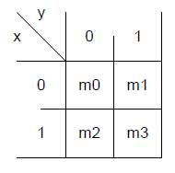
K-Map with 2 Variables
One cell represents a term with two literals
A group of two adjacent cells represent a term with one literal.
A group of four adjacent cells produce a function which is always ‘1’ .
y
x
0
1
x’y’
x’y
0
x
1
xy’
xy

Slide 10






Two-Variable K - Map
Example
 | y
x |  | 0 | 1
 | 0
 | 1
m₀ | m₁
m₂ | m₃
Y
 |  |  | y
 |  | 0 | 1
x |  | 1 | 1
X

Slide 11











Three-Variable K - Map
 | x y z | Minterm
0 | 0 0 0 | m₀
1 | 0 0 1 | m₁
2 | 0 1 0 | m₂
3 | 0 1 1 | m₃
4 | 1 0 0 | m₄
5 | 1 0 1 | m₅
6 | 1 1 0 | m₆
7 | 1 1 1 | m₇
m₀ | m₁ | m₃ | m₂
m₄ | m₅ | m₇ | m₆
 | y z
x |  | 00 | 01 | 11 | 10
 | 0
 | 1

Slide 12



Three-Variable K - Map
Example
 | y z
x |  | 00 | 01 | 11 | 10
 | 0
 | 1
1
One square represents one minterm, giving a term with three literals
 | y z
x |  | 00 | 01 | 11 | 10
 | 0
 | 1
1
1
Two adjacent squares represent a term with two literals

Slide 13


Three-Variable K - Map
Example
 | y z
x |  | 00 | 01 | 11 | 10
 | 0
 | 1
1
1
1
1
Four adjacent squares represent a term with one literal
 | y z
x |  | 00 | 01 | 11 | 10
 | 0
 | 1
1
1
1
1
1
1
1
1
Eight adjacent squares encompass the entire map and always produces F = 1

Slide 14
Slightly Modifying Def. of Adjacent Squares
    We know that minterm of each square differs from that of its neighboring’s minterm by 1 bit (Gray code)
    Does this apply on Squares at the extreme edges?
    e.g. see m₂ and m₀
    See m₆ and m₄
 | y z
x |  | 00 | 01 | 11 | 10
 | 0
 | 1
 | y z
x |  | 00 | 01 | 11 | 10
 | 0
 | 1
m₀ | m₁ | m₃ | m₂
m₄ | m₅ | m₇ | m₆
m₀ | m₁ | m₃ | m₂
m₄ | m₅ | m₇ | m₆

Slide 15
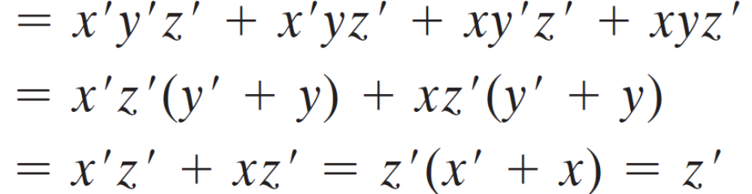
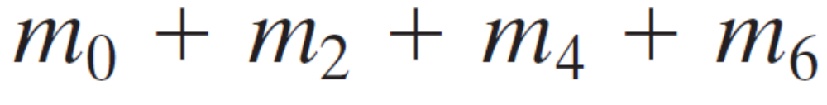

 | y z
x |  | 00 | 01 | 11 | 10
 | 0
 | 1
1
1
1
1

Slide 16



T hree-Variable K - Map
Example
m₀ | m₁ | m₃ | m₂
m₄ | m₅ | m₇ | m₆
 | x y z | Minterm |  | F
0 | 0 0 0 | m₀ |  | 0
1 | 0 0 1 | m₁ |  | 0
2 | 0 1 0 | m₂ |  | 1
3 | 0 1 1 | m₃ |  | 1
4 | 1 0 0 | m₄ |  | 1
5 | 1 0 1 | m₅ |  | 1
6 | 1 1 0 | m₆ |  | 0
7 | 1 1 1 | m₇ |  | 0
 | y z
x |  | 00 | 01 | 11 | 10
 | 0
 | 1
 |  |  |  | y
 |  | 0 | 0 | 1 | 1
x |  | 1 | 1 | 0 | 0
 |  |  | z

Slide 17

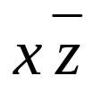


Three-Variable K - Map
Example
m₀ | m₁ | m₃ | m₂
m₄ | m₅ | m₇ | m₆
 | x y z | Minterm |  | F
0 | 0 0 0 | m₀ |  | 0
1 | 0 0 1 | m₁ |  | 0
2 | 0 1 0 | m₂ |  | 0
3 | 0 1 1 | m₃ |  | 1
4 | 1 0 0 | m₄ |  | 1
5 | 1 0 1 | m₅ |  | 0
6 | 1 1 0 | m₆ |  | 1
7 | 1 1 1 | m₇ |  | 1
 | y z
x |  | 00 | 01 | 11 | 10
 | 0
 | 1
 |  |  |  | y
 |  | 0 | 0 | 1 | 0
x |  | 1 | 0 | 1 | 1
 |  |  | z
Extra

Slide 18


T Three-Variable K - Map
Example
m₀ | m₁ | m₃ | m₂
m₄ | m₅ | m₇ | m₆
 | x y z | Minterm |  | F
0 | 0 0 0 | m₀ |  | 1
1 | 0 0 1 | m₁ |  | 0
2 | 0 1 0 | m₂ |  | 1
3 | 0 1 1 | m₃ |  | 0
4 | 1 0 0 | m₄ |  | 1
5 | 1 0 1 | m₅ |  | 1
6 | 1 1 0 | m₆ |  | 1
7 | 1 1 1 | m₇ |  | 0
 | y z
x |  | 00 | 01 | 11 | 10
 | 0
 | 1
 |  |  |  | y
 |  | 1 | 0 | 0 | 1
x |  | 1 | 1 | 0 | 1
 |  |  | z

Slide 19

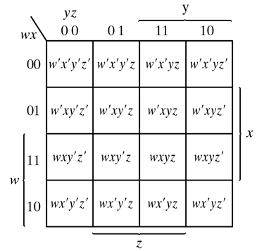
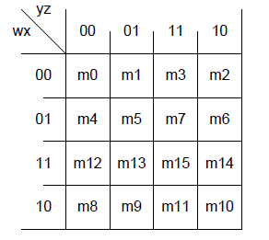
K-Map with 4 Variables

Slide 20
K-Map with 4 Variables
One cell represents a term with four literals
A group of two adjacent cells represent a term with three literals.
A group of four adjacent cells represent a term with two literals.
A group of eight adjacent cells represent a term with one literal.
A group of sixteen adjacent cells produce a function which is always ‘1’ .

Slide 21
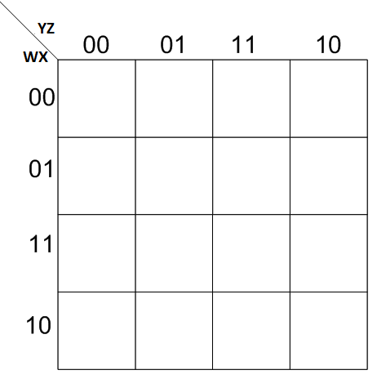
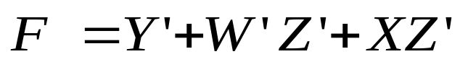
Example:
Y’
W’Z’
1
1
1
1
1
1
1
1
1
1
1
XZ’

Slide 22
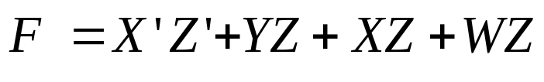
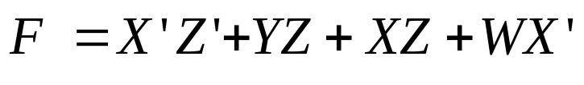
Advance k-map
The simplified expression of a function obtained from k-map is not unique . It is sometimes possible to find two or more expressions that satisfy the minimization criteria. In that case either solution is satisfactory.
X’Z’
YZ
X’Z’
YZ
1
1
1
1
1
1
XZ
1
1
XZ
1
1
WZ
1
1
1
1
WX’
1
1
1
1
1
1
1
1

